Slide 1
Data Exploration and Viz.
Jasyot Gaur

Slide 2




Data Merging

Slide 3
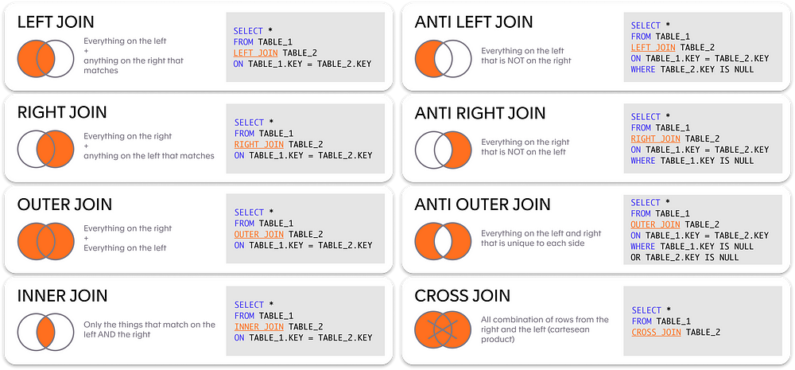
Types of Joins

Slide 4
Grouping, Transforming, and Aggregating
Grouping works only for aggregation.
Steps:
1. Group the dataset by a feature (called a grouped df)
2. You can run the aggregation on the grouped df or on a feature selected from grouped df ONLY!

Slide 5

Python Workbook!

Slide 6
Data Viz

Slide 7
Exercise
How many 7’s do you see?
697042593474935872829495464244396854634235665878937632471

Slide 8
Exercise
How about now?
697042593474935872829495464244396854634235665878937632471

Slide 9
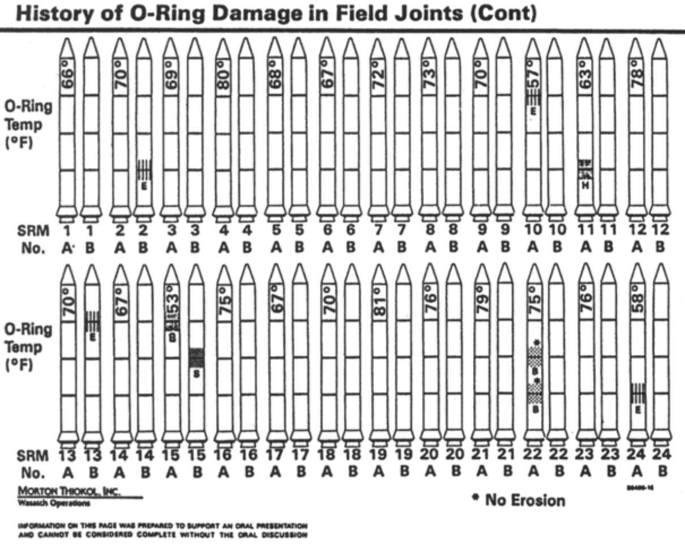
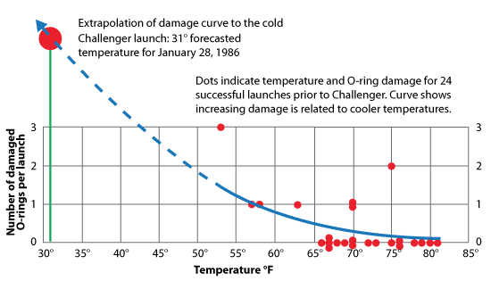
Exercise

Slide 10

Hicks Law (1951)
"The more choices you present your users with, the longer it will take them to reach a decision."

Slide 11

CRISP –DM
Cross-Industry Standard Process for Data Mining.
Invented in 1996 but is still applicable to today’s problems.
EDA: Identify patterns, trends, and relationships between variables
Corporate data is mostly messy and dirty.
Limitations before you model.

Slide 12
Stages of EDA
Variable Identification
Data Structuring
Univariate Analysis
Bivariate Analysis
Missing Value Analysis
Outlier Analysis
Variable Transformation
Feature Engineering
Data Exploration (Today’s Session)
Data Preparation

Slide 13
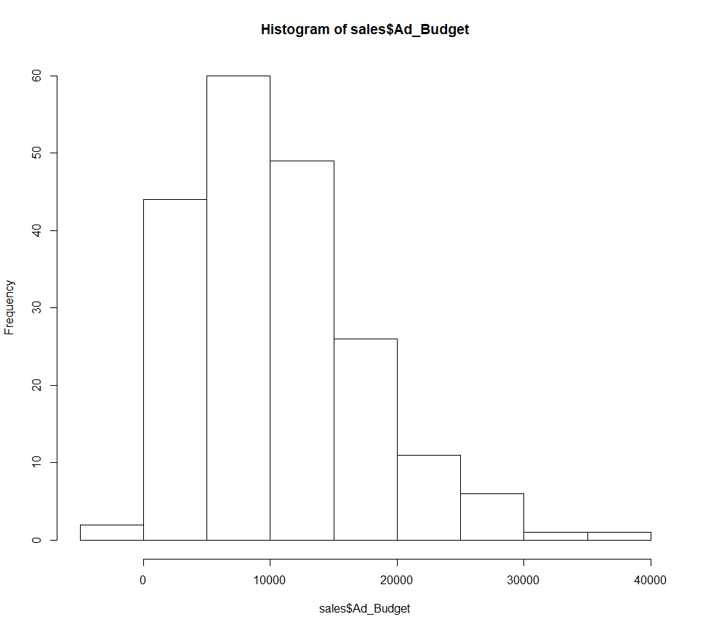
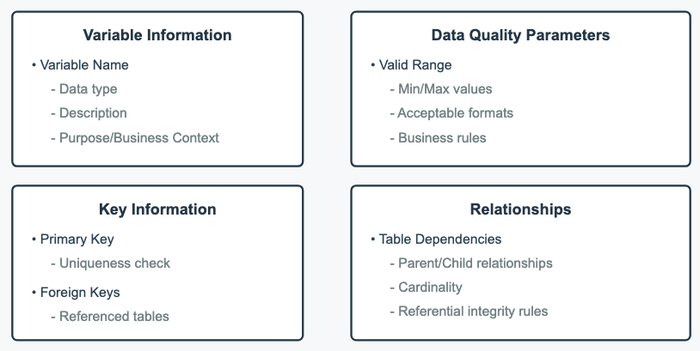
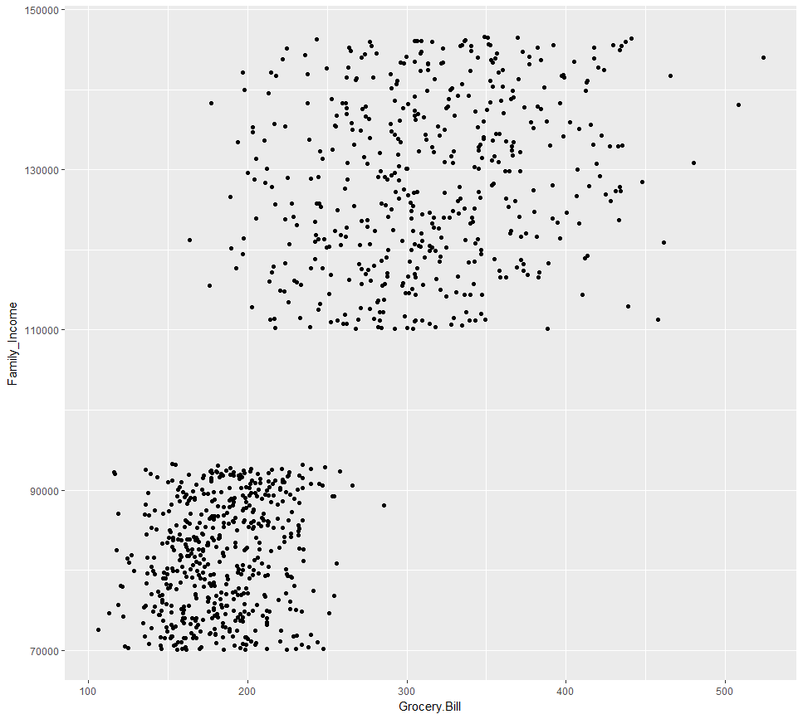
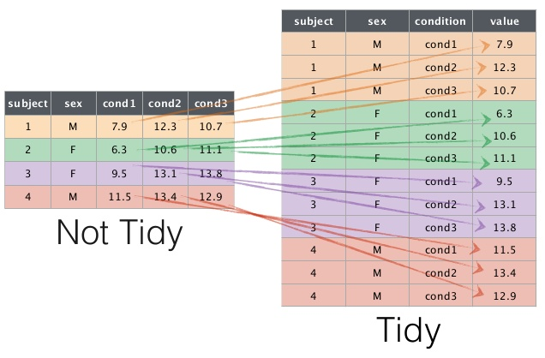
Stages of EDA

Slide 14
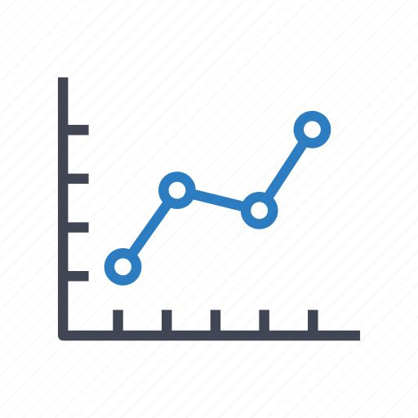
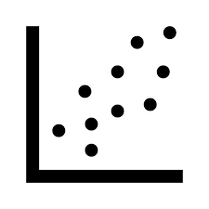


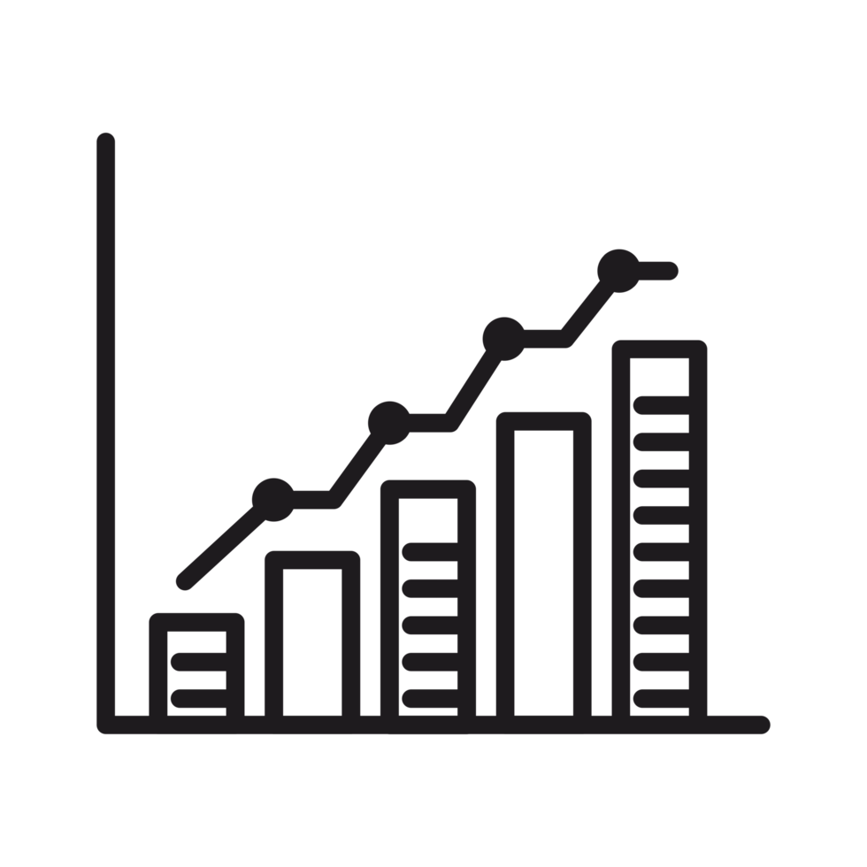
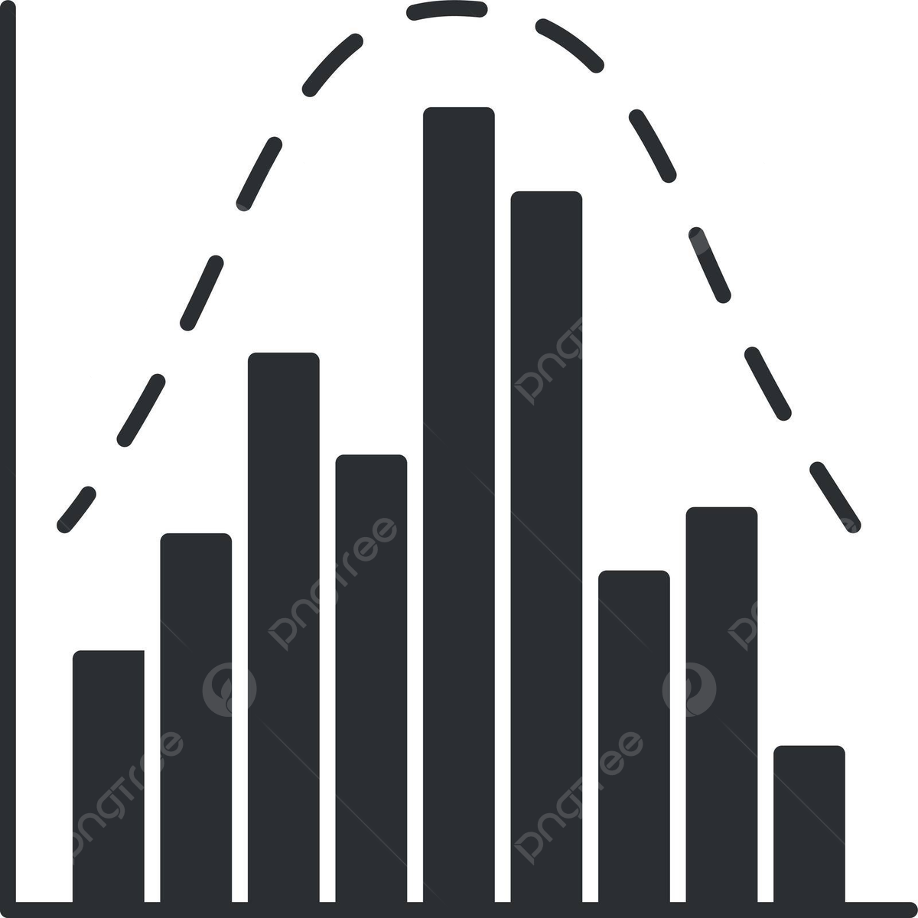
Types of Viz.

Slide 15
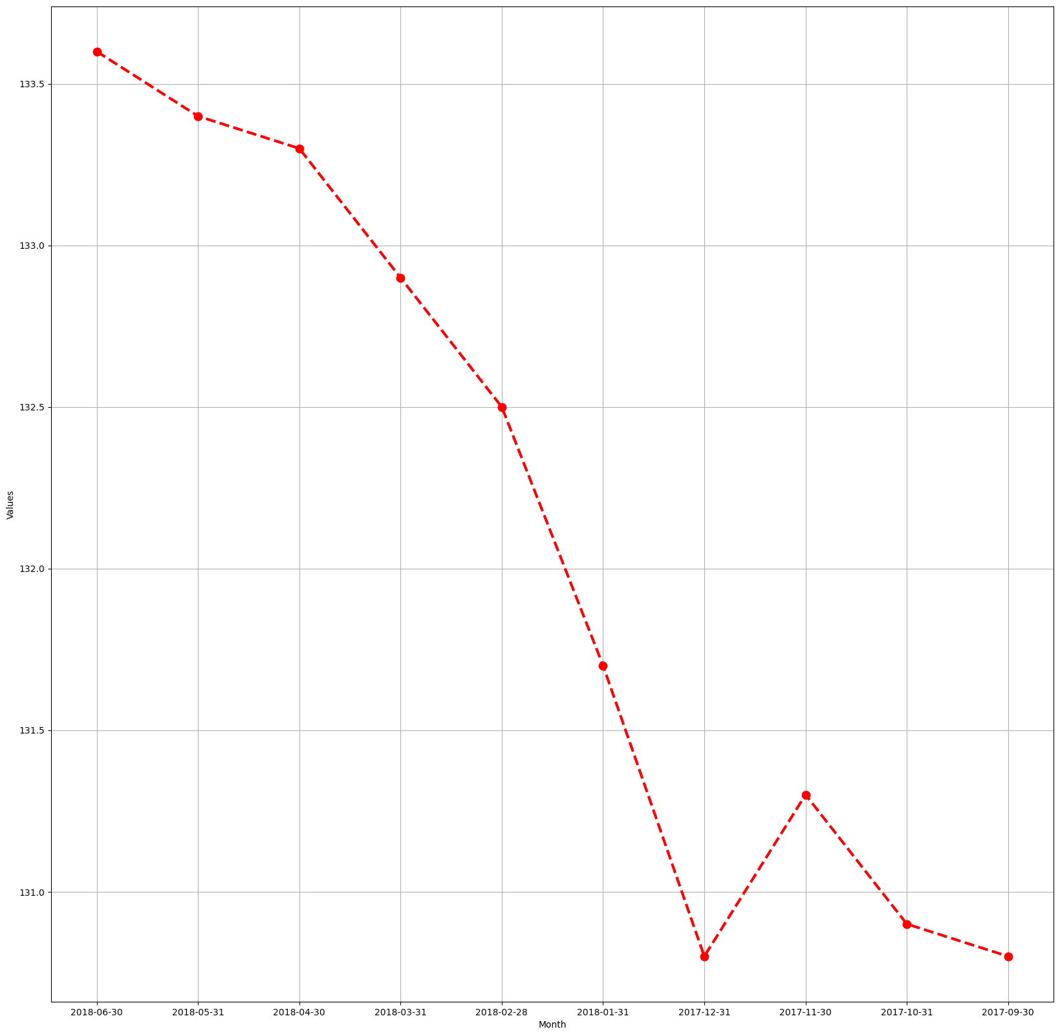
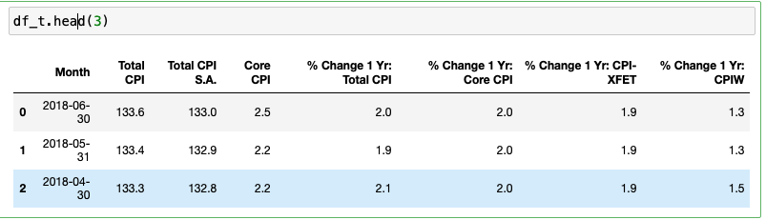


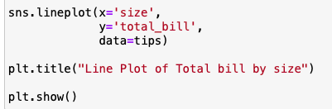
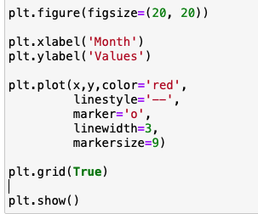
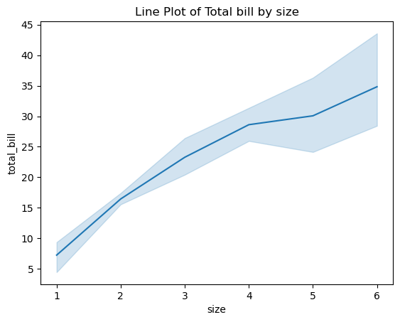
1. Line Chart
Used to show continuous data.

Slide 16
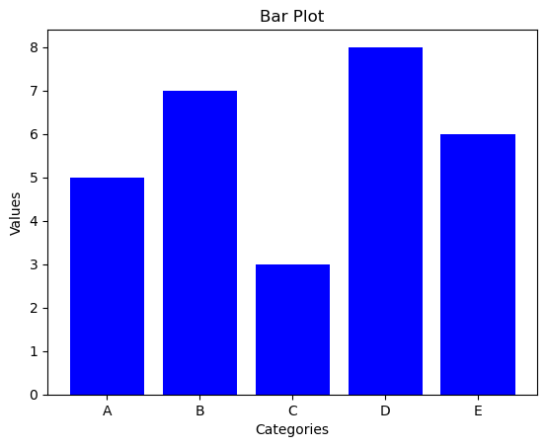

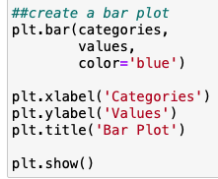
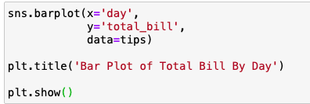
2. Bar Plot
Used to display count (f) for discrete categorical data

Slide 17
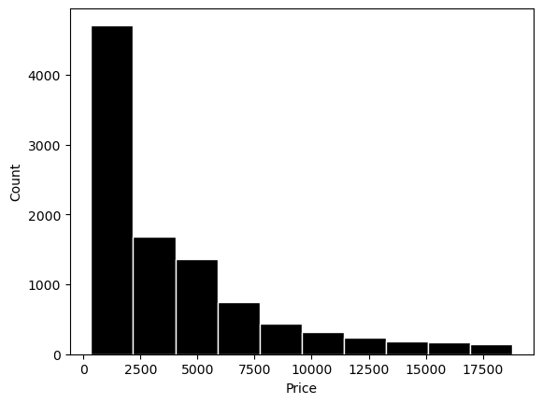
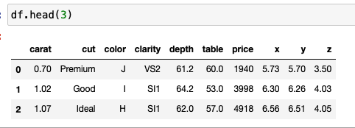
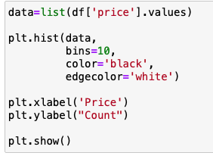

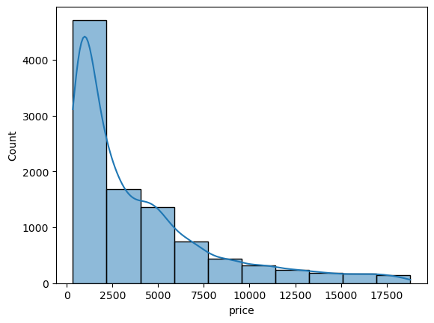
3. Histogram
Used to show data distribution for continuous data.

Slide 18
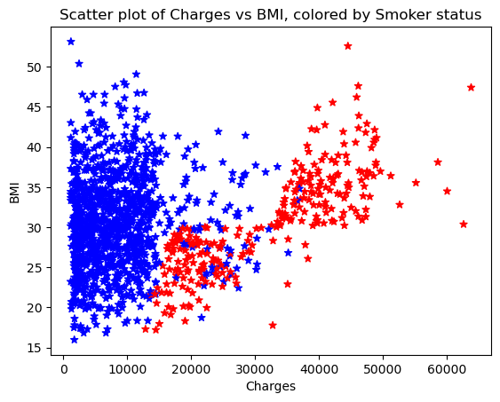
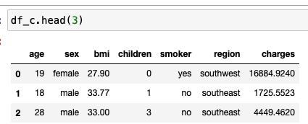
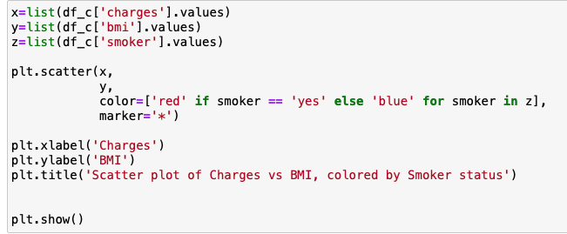
4. Scatter Plots
Used to show relationship between two continuous data

Slide 19
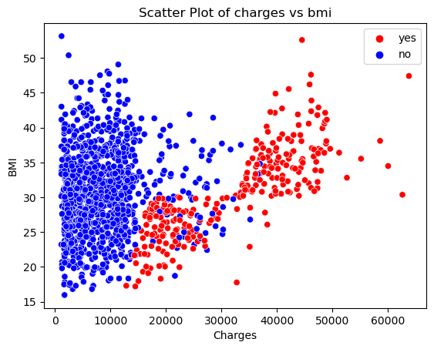
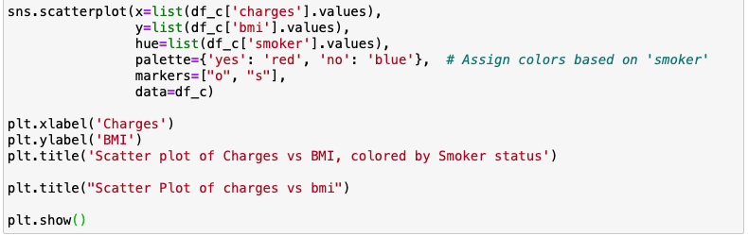
4. Scatter Plots

Slide 20
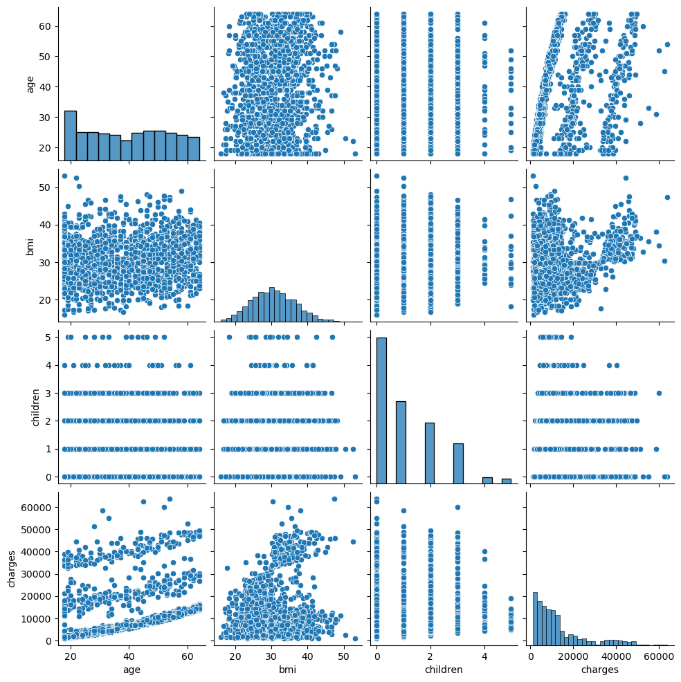

Pairplot()
sns.pairplot() is a Seaborn function used for visualizing relationships between multiple variables in a dataset through a grid of scatter plots and histograms (or kernel density estimates)

Slide 21
Python Notebook!

Slide 22
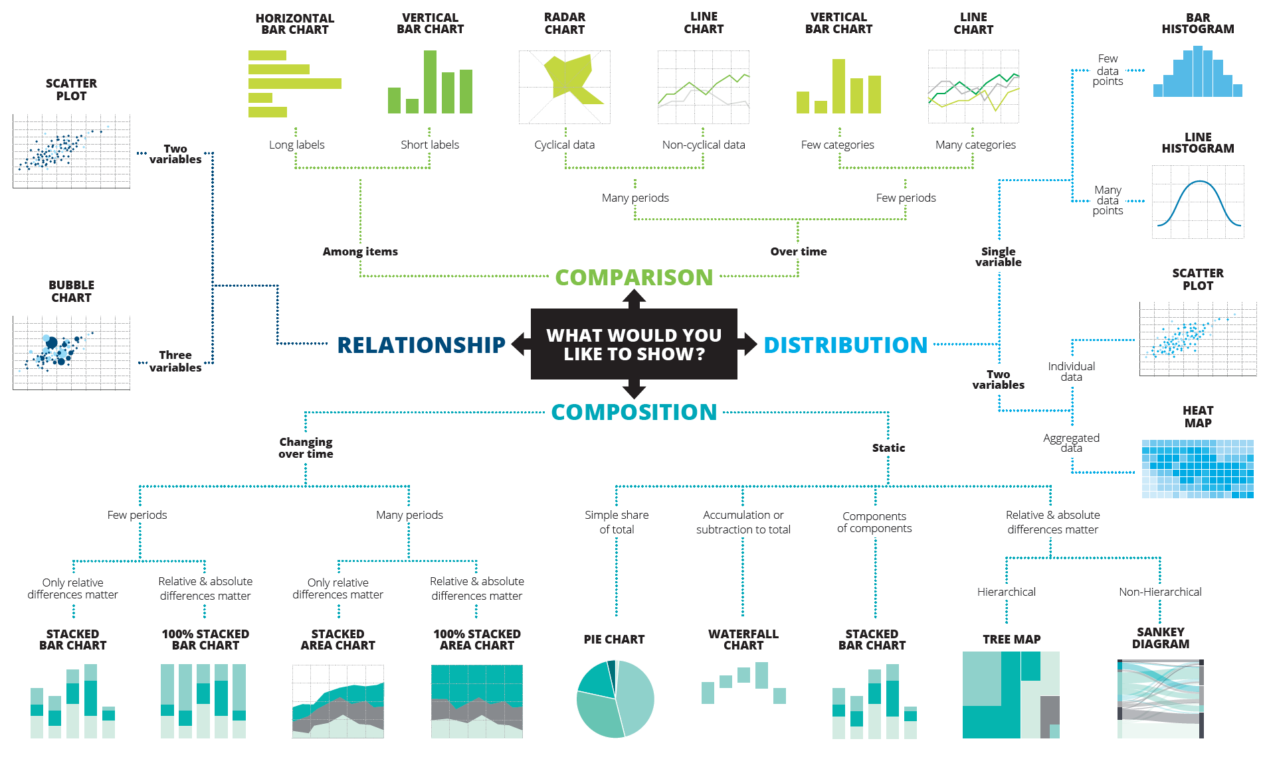
Cheat Sheet
COMPARISON
RELATIONSHIP
DISTRIBUTION
COMPOSITION

